Slide 1
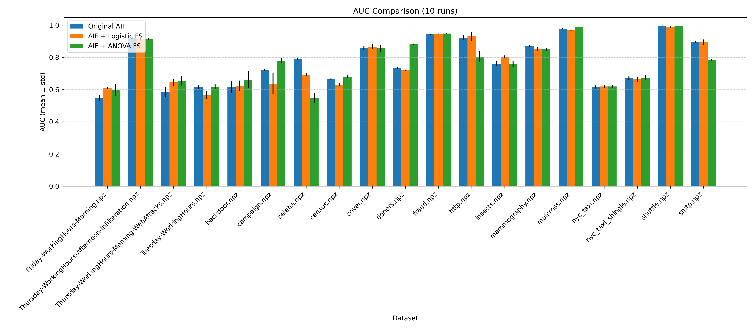
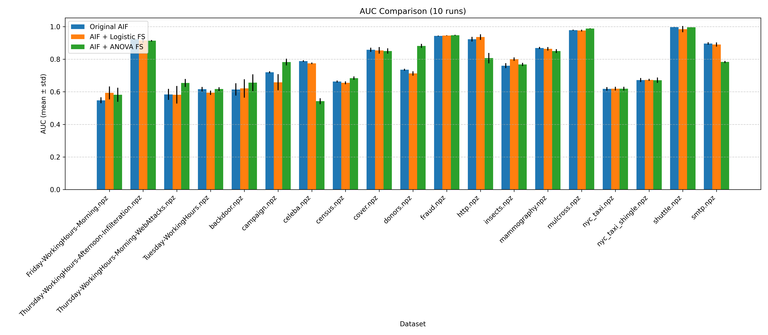
With buffer 8 (win=6)
With buffer 50 (win=4)

Slide 2
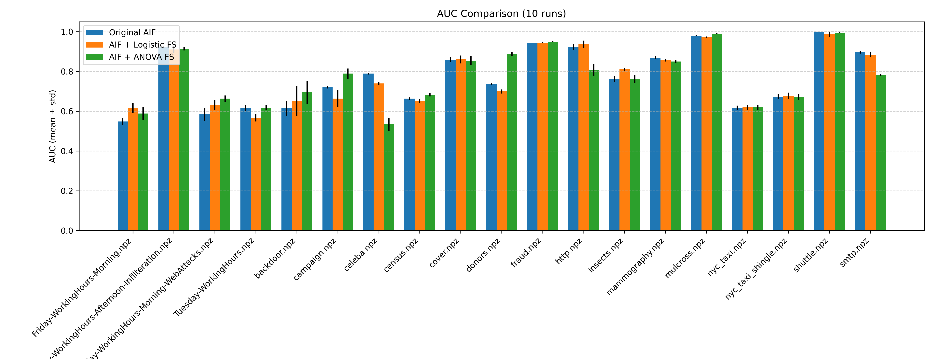
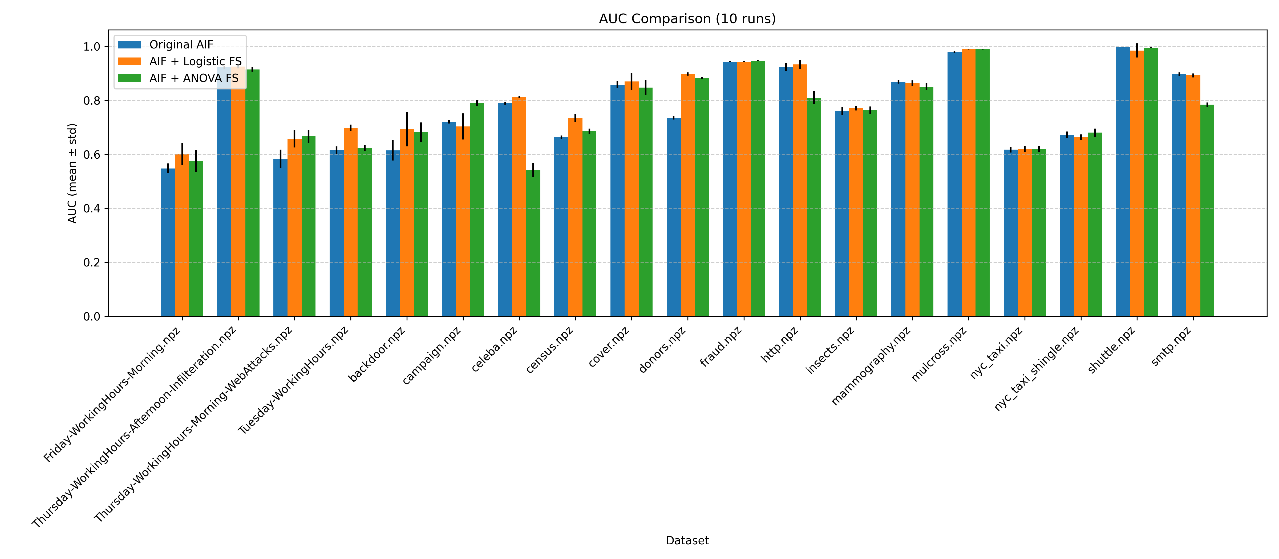
With buffer 16 (win=6)
With no buffer (win=11)

Slide 3
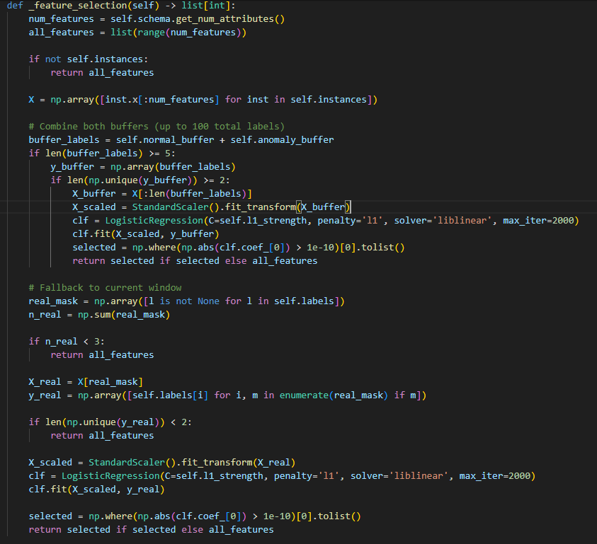

Slide 4
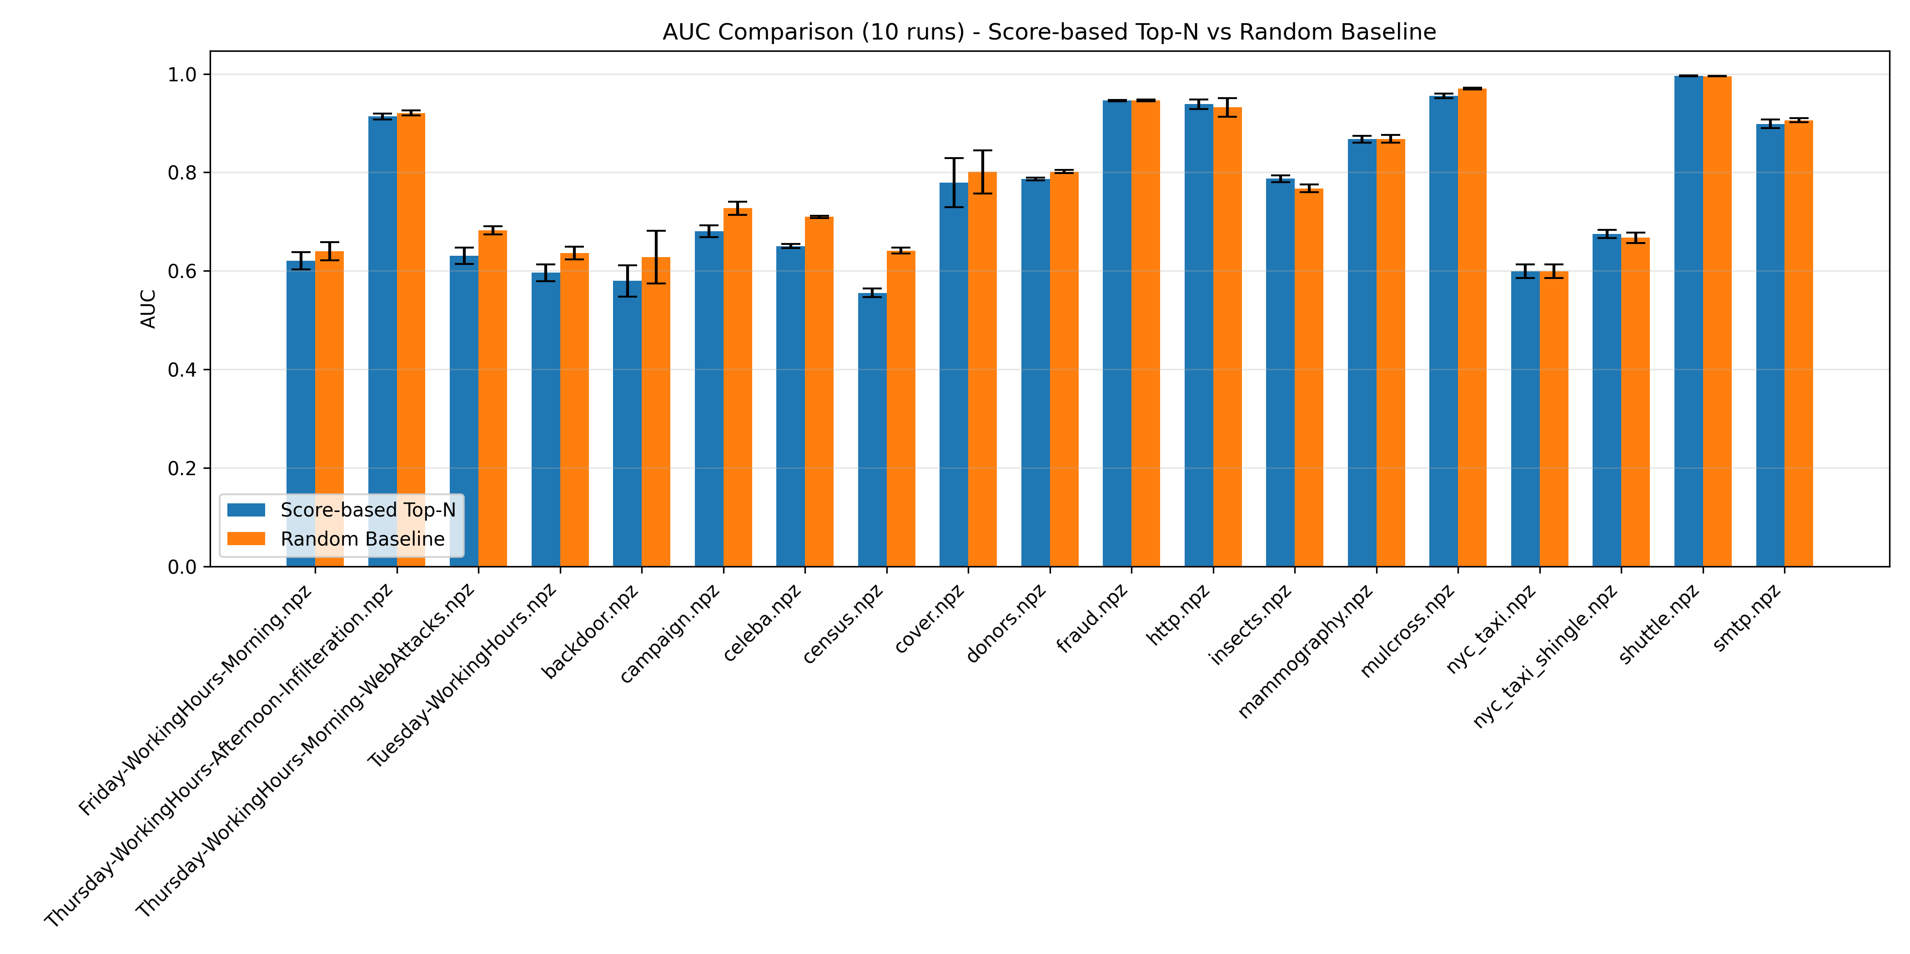
Week 2
Used the active learning method.

Slide 5
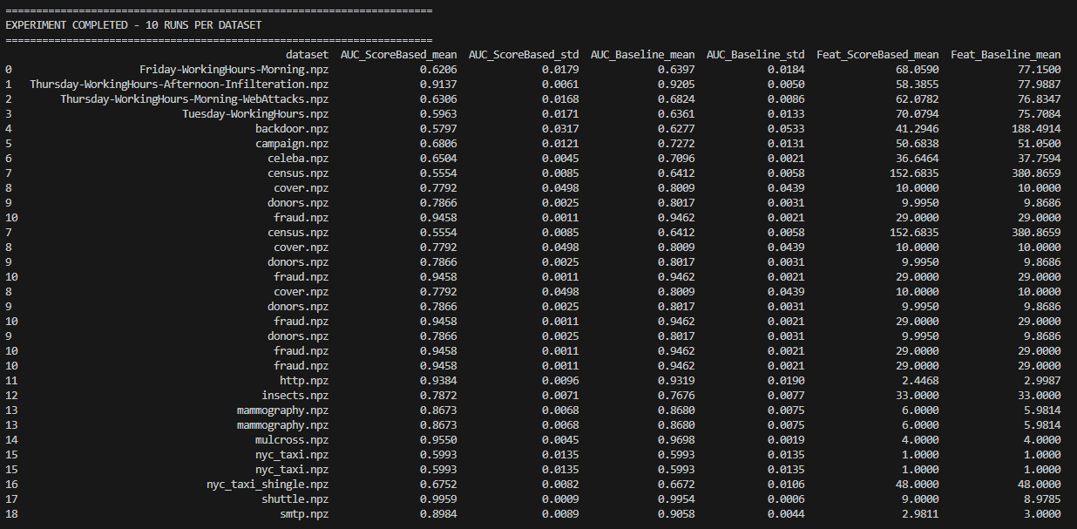

Slide 6
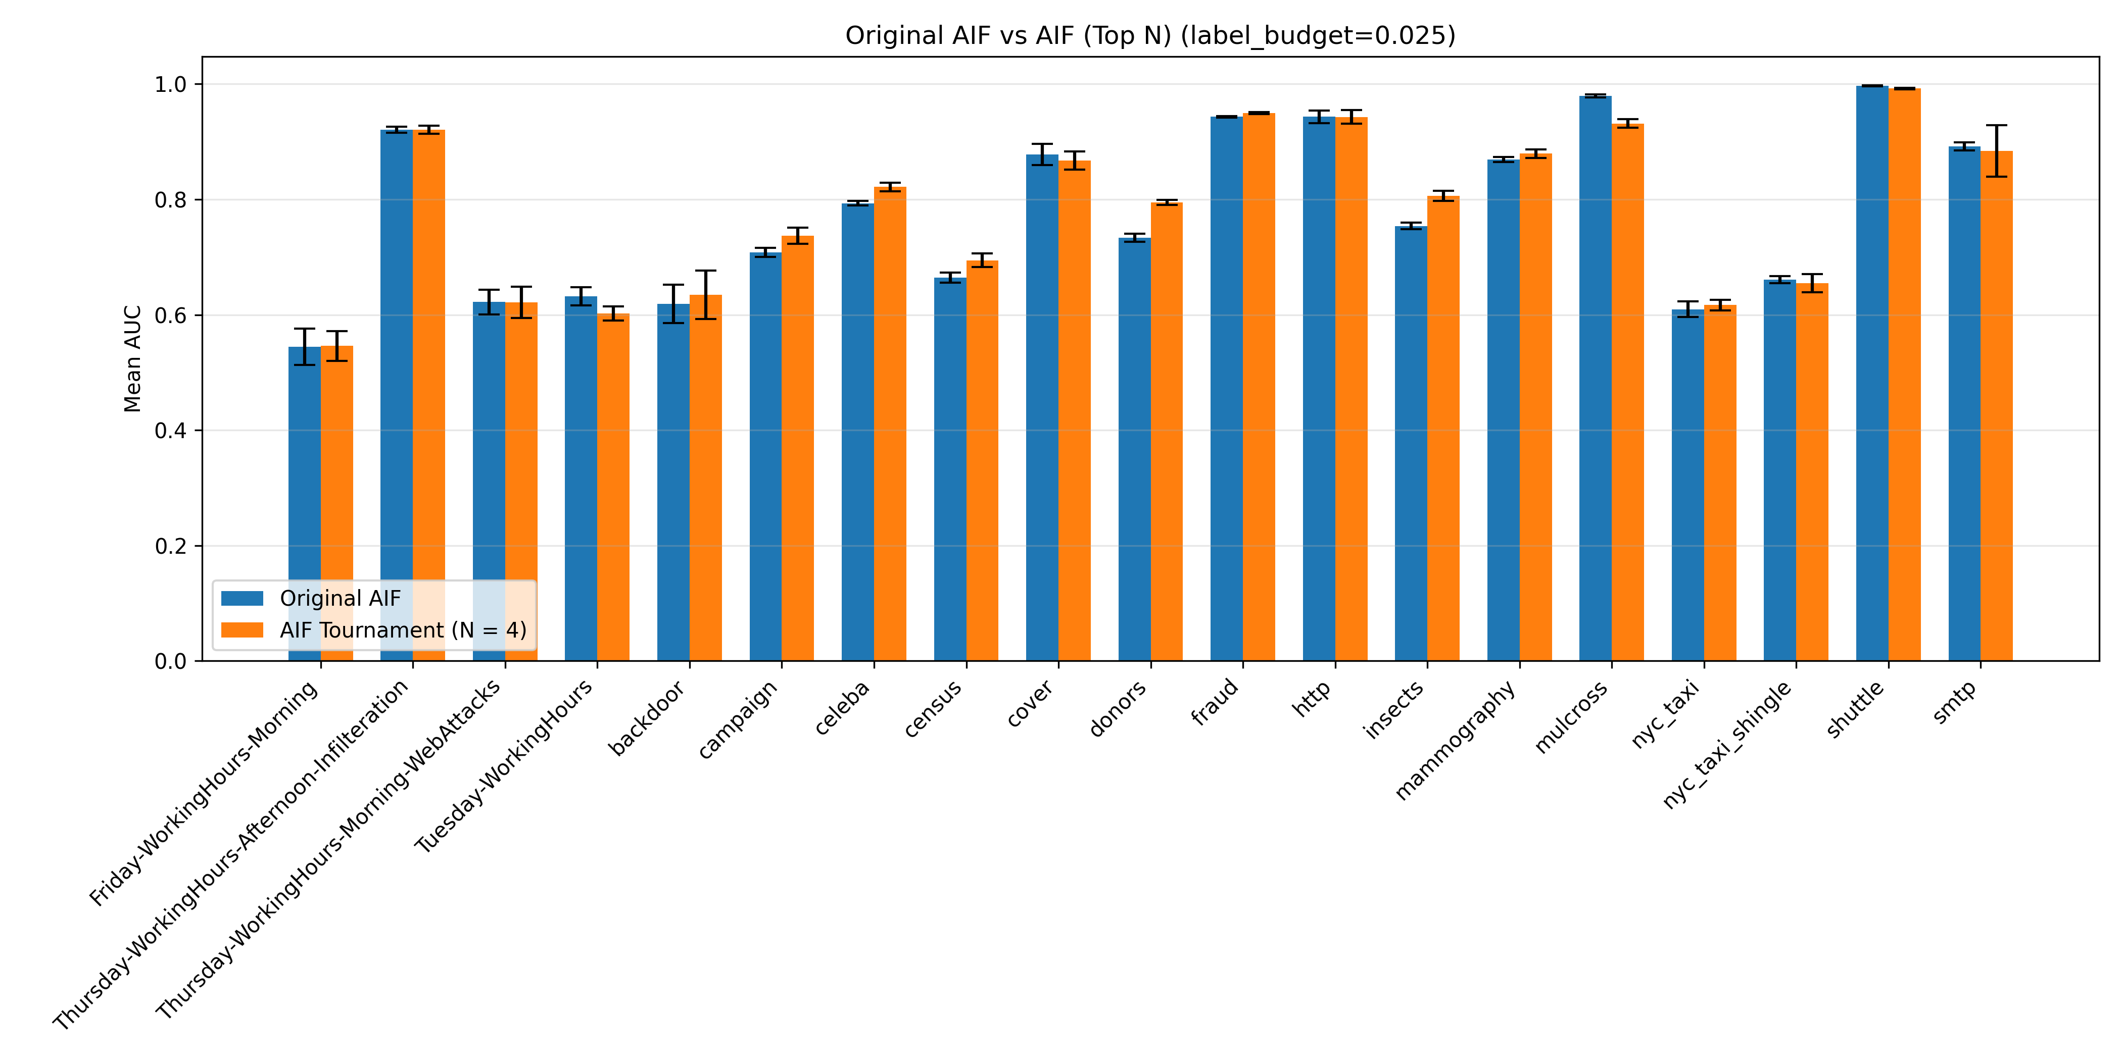


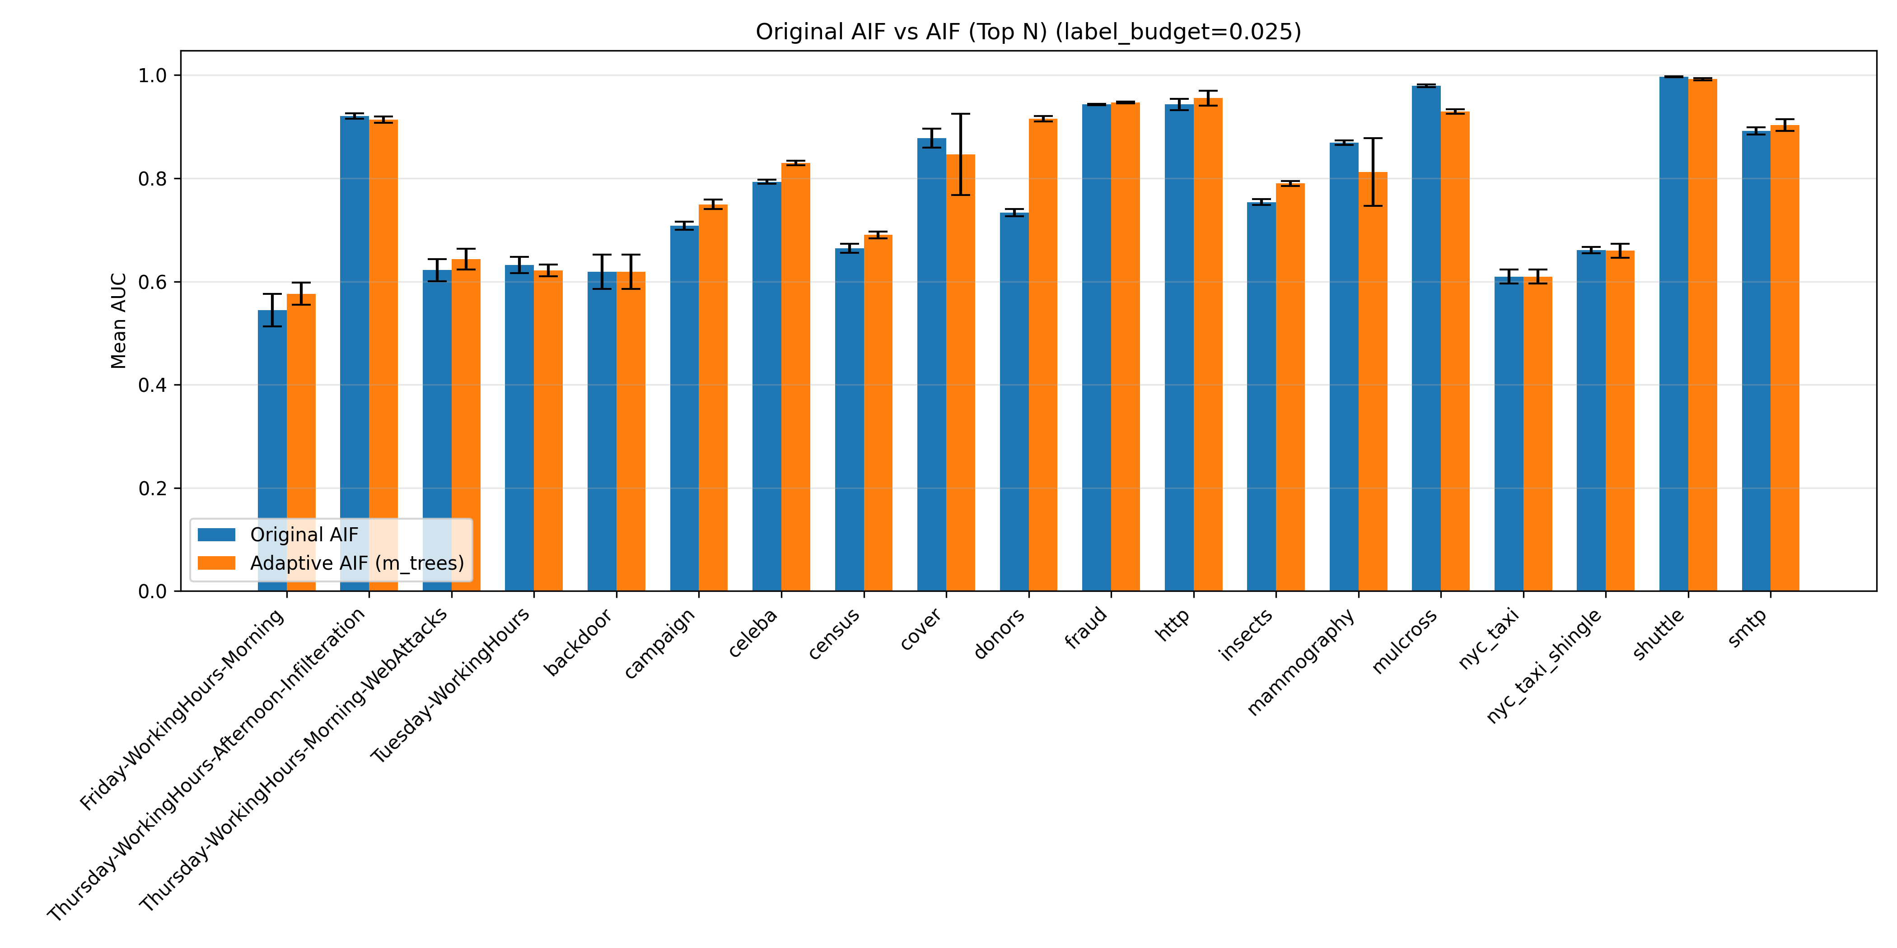
N = 5 (14)
N = 4 (10)
N = 4
N = 2 (10)
Global (12)

Slide 7

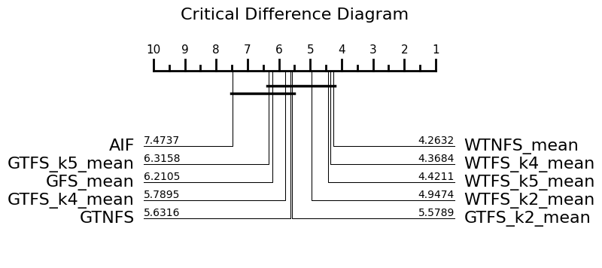
Feature selection technique ranking

Slide 8

Basic Feature selection model Ranking

